Slide 1

Software development for autonomous vehicles
Koral Tayeb (207423757)
Matan Sharazki (206036063)

Slide 2
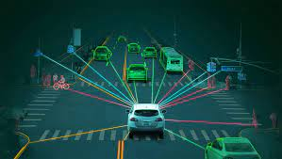
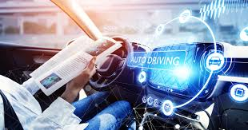
Introduction
An autonomous car is a vehicle capable of sensing its environment and operating without human involvement. A human passenger is not required to take control of the vehicle at any time, nor is a human passenger required to be present in the vehicle at all. An autonomous car can go anywhere a traditional car goes and do everything that an experienced human driver does.
The Society of Automotive Engineers (SAE) currently defines 6 levels of driving automation ranging from Level 0 (fully manual) to Level 5 (fully autonomous). These levels have been adopted by the U.S. Department of Transportation.

Slide 3
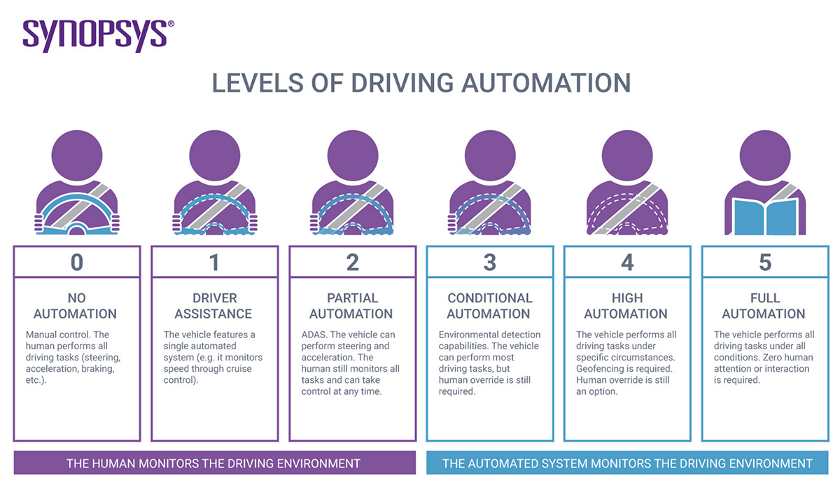

Slide 4
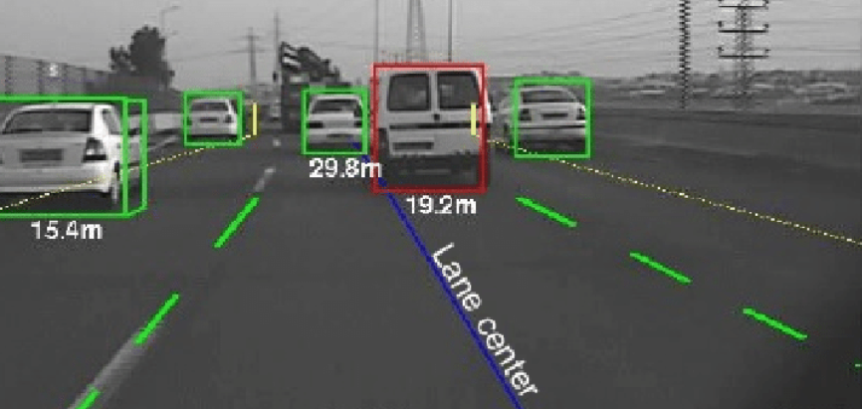
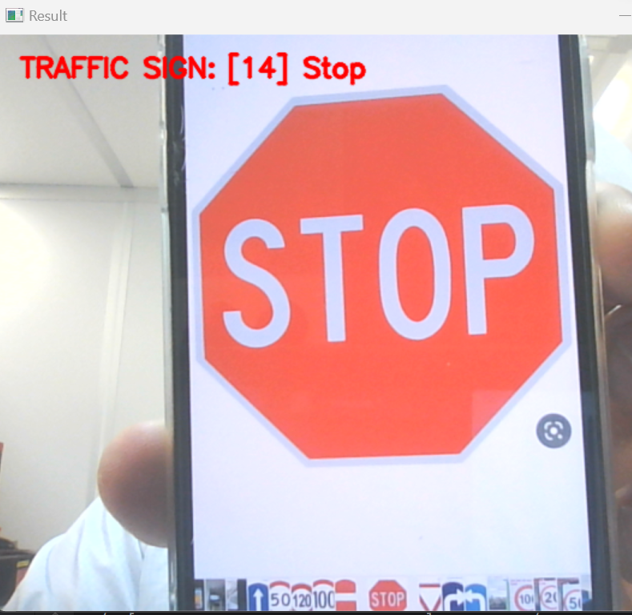
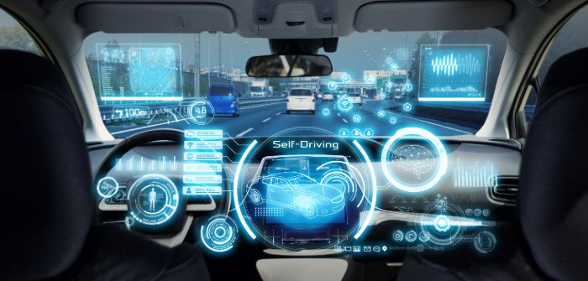
What do we learn from this course?
Using Linux, Python, C++ for Robotics.
What sensors are required for an autonomous car and how to access them using ROS.
How to do autonomous navigation using a GPS.
Which sensors needs for autonomous cars.
* ROS:
Robotic Operating System - a set of software libraries and tools that help to build robot applications
Ros online link

Slide 5
How do autonomous cars work?
Autonomous cars rely on sensors, actuators, complex algorithms, machine learning systems, and powerful processors to execute software.
Autonomous cars create and maintain a map of their surroundings based on a variety of sensors situated in different parts of the vehicle. Radar sensors monitor the position of nearby vehicles. Video cameras detect traffic lights, read road signs, track other vehicles, and look for pedestrians. Lidar (light detection and ranging) sensors bounce pulses of light off the car’s surroundings to measure distances, detect road edges, and identify lane markings. Ultrasonic sensors in the wheels detect curbs and other vehicles when parking.
Sophisticated software then processes all this sensory input, plots a path, and sends instructions to the car’s actuators, which control acceleration, braking, and steering. Hard-coded rules, obstacle avoidance algorithms, predictive modeling, and object recognition help the software follow traffic rules and navigate obstacles.

Slide 6
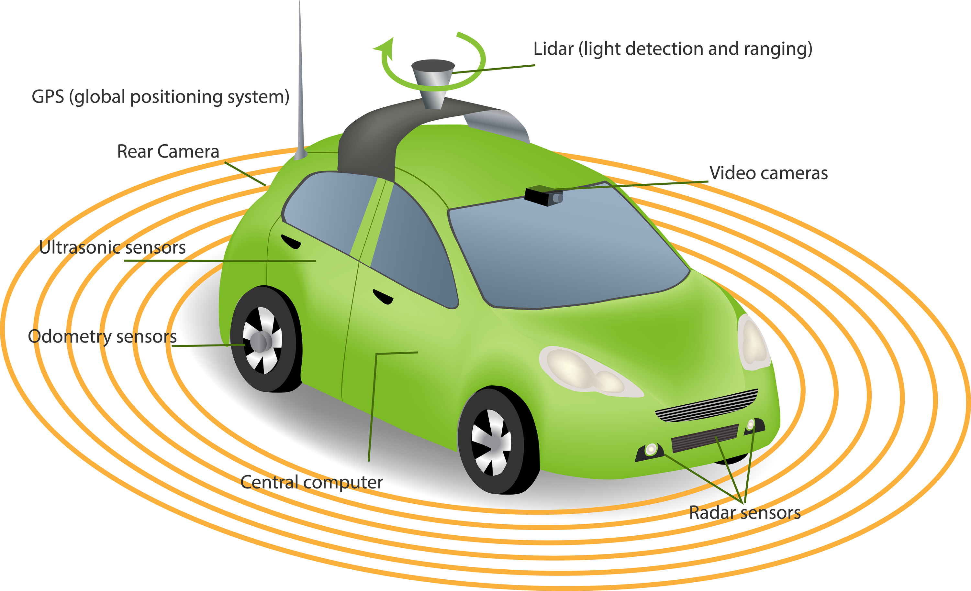

Slide 7
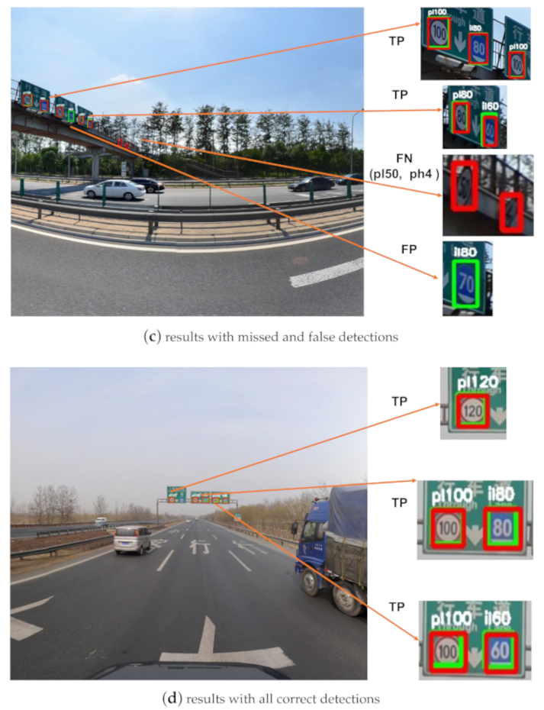
The camera sensor
The camera is very important sensor in autonomous cars because it allows to identify objects and people.
Vision is the main source of information in self-driving vehicles. For it to steer by itself, it needs to “see”, understand, and sense the surrounding world just as a human would.
The most common cameras that used for this purpose is 360-degree cameras.

Slide 8

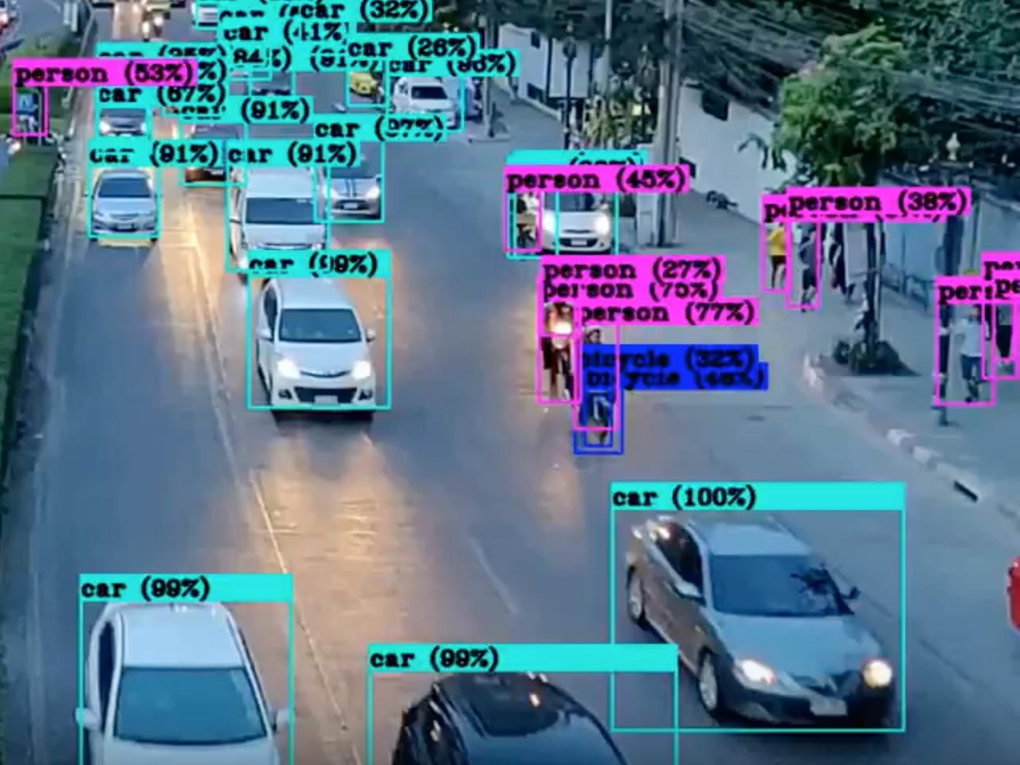
Traffic signs recognition using OpenCV and machine learning
In our project we chose to understand how the camera sensor works.
When you go on the road, you see various traffic signs like traffic signals, turn left or right, speed limits, no passing of heavy vehicles, no entry, children crossing, etc., that you need to follow for a safe drive. Likewise, autonomous vehicles also have to interpret these signs and make decisions to achieve accuracy. The methodology of recognizing which class a traffic sign belongs to is called Traffic signs classification.
Traffic signs detection and classification in real-time will be done using OpenCV using a simple webcam.

Slide 9
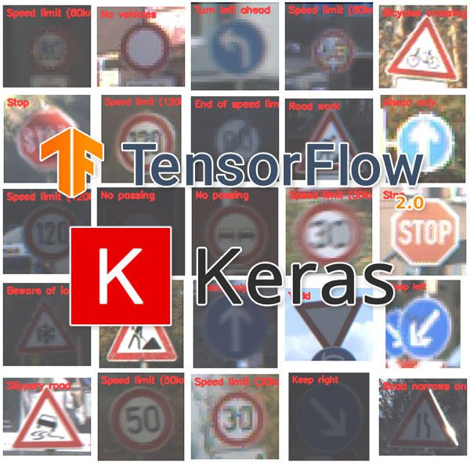
What we built in our project
In this Deep Learning project, we will build a model for the classification of traffic signs available in the image into many categories. This project presents a study to recognize traffic sign patterns using Convolutional Neural Network (CNN)* and Keras** models. The Neural Networks stages are performed to recognize the traffic sign patterns. The system is trained and validated to find the best sign fit and introduce it to the user. The experimental results show the highly accurate classifications of traffic sign patterns.

Slide 10
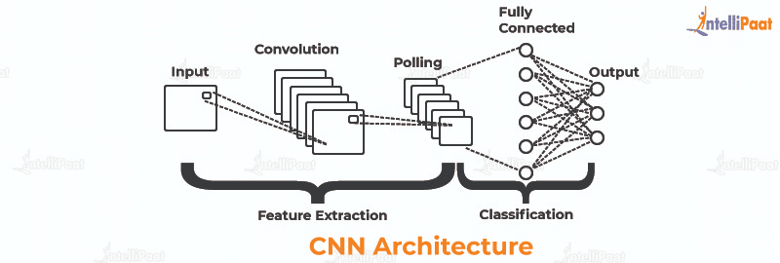
CNN and Keras
A CNN is a kind of network architecture for deep learning algorithms and is specifically used for image recognition and tasks that involve the processing of pixel data. There are other types of neural networks in deep learning, but for identifying and recognizing objects, CNNs are the network architecture of choice.
Keras is an open-source software library that provides a Python interface for artificial neural networks. Keras acts as an interface for the TensorFlow library.
Keras is used by companies such as Netflix, Yelp, Uber, etc.

Slide 11
Development process
Import the signs Images database
Split the data to train, test and validation arrays
Preprocessing the Images in order to make the class inclusive and generic
Cration of Convolution Neural Network Model
Train the model
Set up the Video Camera Constintently
Predict Image by class recognation, and present the result in real-time
Read Image using OpenCV

Slide 12

The results of our model

Slide 13

Conclusions
Traffic Sign Recognition (TSR) is used to regulate traffic signs, warn a driver, and command or prohibit certain actions.
A fast real-time and robust automatic traffic sign detection and recognition can support and disburden the driver and significantly increase driving safety and comfort.

Slide 14

Bibliography
The Construsction
01
https://app.theconstructsim.com/#/Home
Towards data science
02
https://medium.com/towards-data-science/building-a-real-time-object-recognition-app-with-tensorflow-and-opencv-b7a2b4ebdc32
YouTube
03
https://www.youtube.com
Github
https://github.com/murtazahassan/Learn-OpenCV-in-3-hours
04

Slide 15


